Slide 1

Presentation on Research Project Automated Hospital ICU Emergency Signaling System
Supervisors
Dr. Tarem Ahmed
Dr. Mohammad Faisal Uddin
Presentation by
Nazifa M Shemonti
Saifur Rahman
Shifat Uddin

Slide 2

KOAD Algorithm Background
Kernel-based Online Anomaly Detection
Development and application in ICU conceptualized by Dr. Ahmed
Previously implemented in network traffic anomaly detection, intruder detection

Slide 3
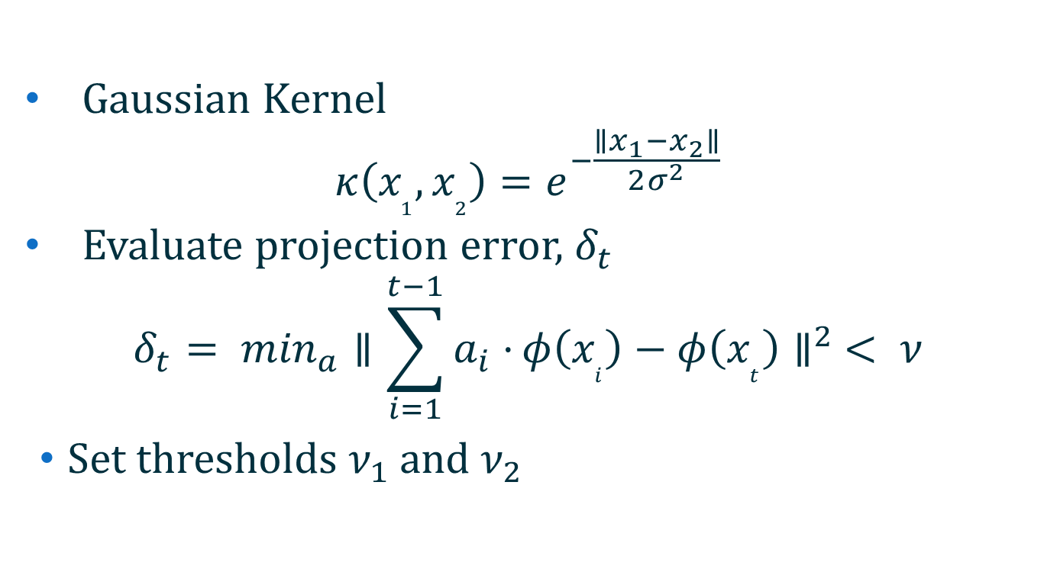
KOAD Algorithm PROPERTIES
Gaussian Kernel
$$κ\left(x_{1}, x_{2}\right)=e^{−\frac{∥x_{1}−x_{2}∥}{2σ^{2}}}$$
Evaluate projection error, $δ_{t}$
$$δ_{t}= \min_{a}{∥\sum_{i=1}^{t−1}{a_{i}⋅}φ\left(x_{i}\right)−φ\left(x_{t}\right)∥}^{2} < ν$$
Set thresholds $ν_{1}$and $ν_{2}$

Slide 4
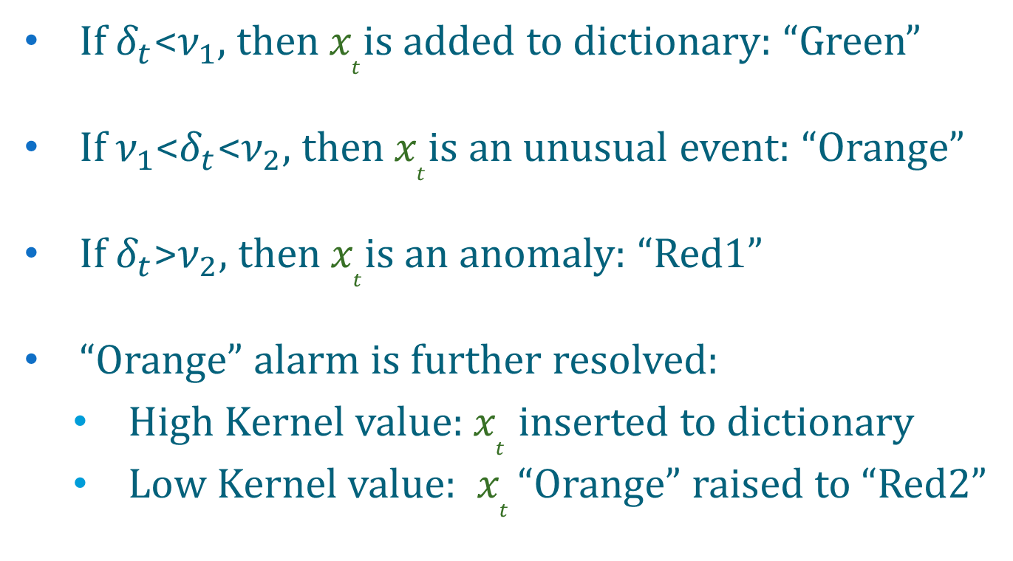
KOAD Algorithm ANOMALY DETECTION & SIGNALING
If $δ_{t}$<$ν_{1}$, then${ x}_{t}$is added to dictionary: “Green”
If $ν_{1}$<$δ_{t}$<$ν_{2}$, then${ x}_{t}$is an unusual event: “Orange”
If $δ_{t}$>$ν_{2}$, then${ x}_{t}$is an anomaly: “Red1”
“Orange” alarm is further resolved:
High Kernel value:${ x}_{t}$ inserted to dictionary
Low Kernel value: ${ x}_{t}$“Orange” raised to “Red2”

Slide 5
KOAD Algorithm CASE FOR HOSPITAL ICU IMPLEMENTATION
Tackles storage and computational complexity
Dictionary size does not grow indefinitely
Possible to process multiple readings

Slide 6
KOAD Algorithm CASE FOR IMPLEMENTATION in bANGLADESH
Convenient for hospitals
Manual recording can be phased out
User friendly interface

Slide 7
ICU Survey Overview
Conducted at:
Islami Bank Hospital
Euro-Bangla Heart Hospital
Chittagong Medical Hospital
National Heart Foundation Hospital & Research Institute
Outcomes:
Patient Monitoring Unit (PMU) used
Method of recording vital statistics
Notes:
Before conducting our research, like any other successful project, we decided to go some of the hospitals around the country to get the actual picture in the field. We have visited Islami Bank Hospital , Euro bangla, Ctg Med and finally NHFH. The things we found quite interesting!

Slide 8
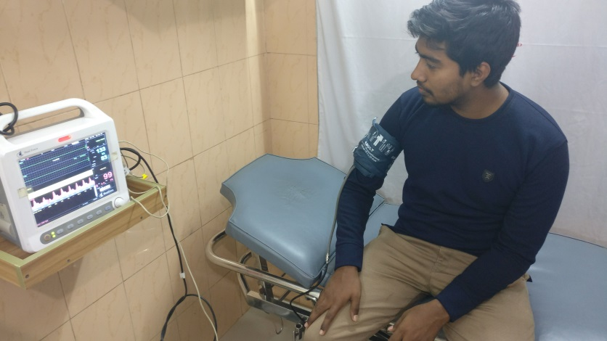
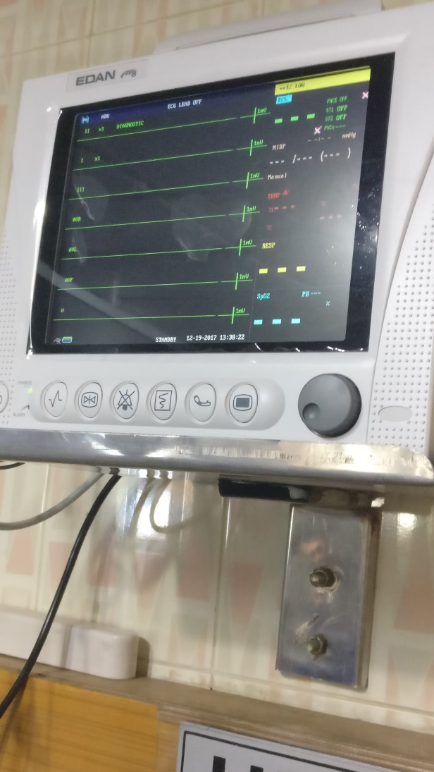
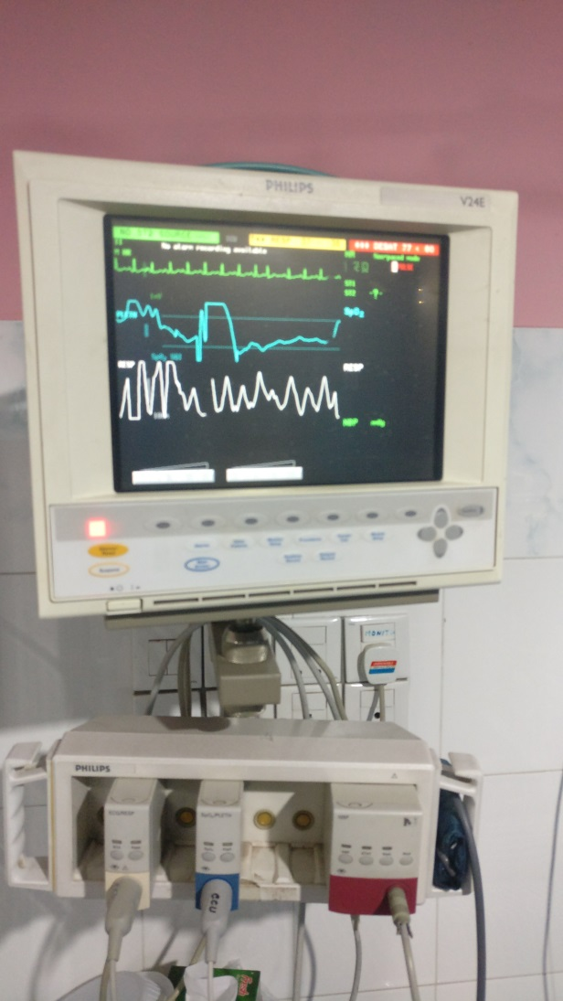
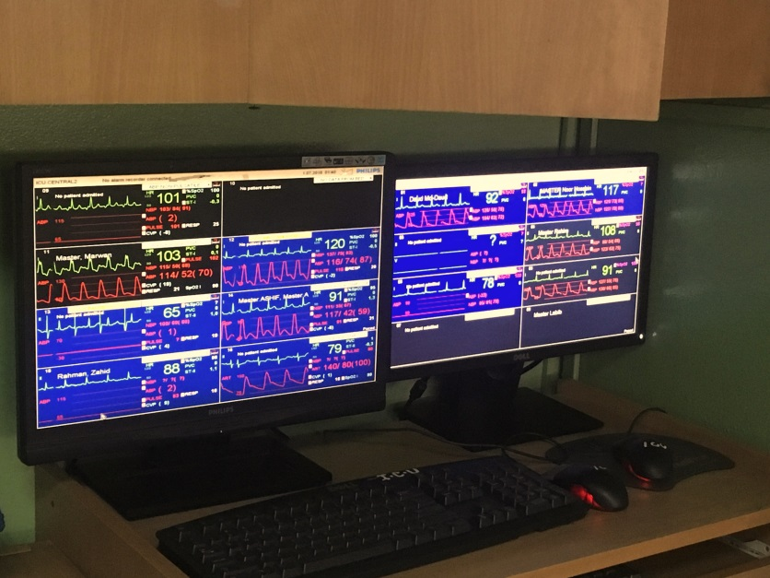
ICU Survey PMU
Notes:
Doctors there especially at the ICU’s mainly focus on the patient and not much on the electronics. Normally the attached probes of PMUs to every patient at the ICU where every PMU shows real-time reading of different parameter of each patient. However in some hospitals like NHFH, where they have central monitor, the in charge can only see videos display of each PMU.

Slide 9
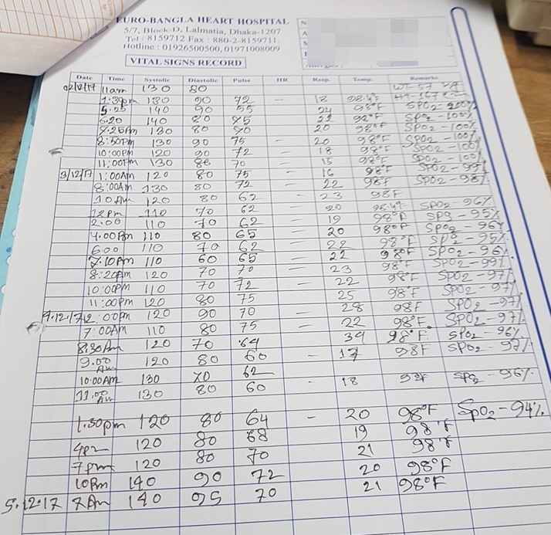
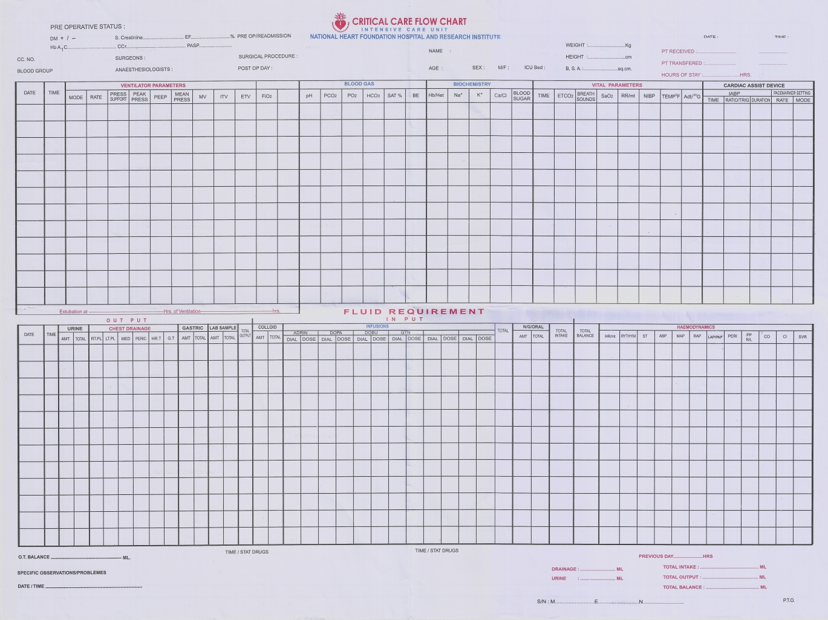
Manual Recording of Vital Statistics at Euro-Bangla Heart Hospital
Notes:
Surprisingly the doctors at the ICUs analyze the data on pen and paper so digital data storage and analysis not really practiced in our country.

Slide 10
ICU Survey NHFH&RI ACCESS
Approvals from both Academic Council and Ethical Review Committee
Conditions:
Data nondisclosure to third party
Protect anonymity of subjects
Follow international guideline for data protection
Notes:
We managed the approvals from AC and ERC of NHFH so as a result we are allowed to work in restricted workspace and hands on research on those expensive Philips PMUs.

Slide 11
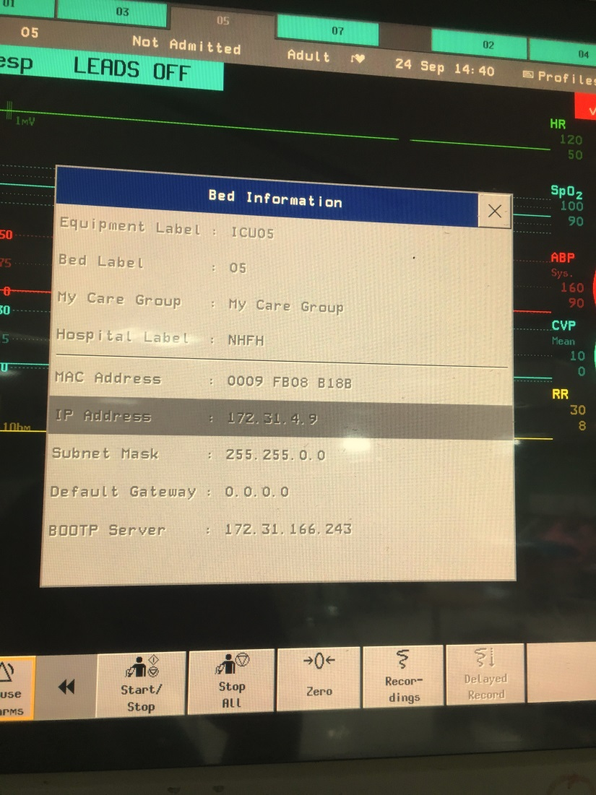
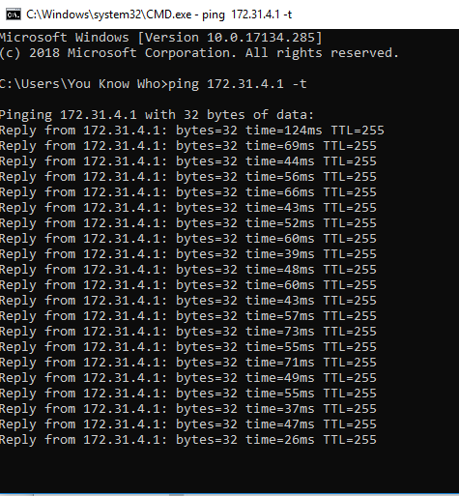
Data Extraction Connectivity via lan
Notes:
The network we found at NHFH&RI is like, there is a bootp server assigning dynamic IP addresses to each pmu. So we decided to put a switch between the server and pmu. Then manually assign an IP of same network block to the NIC of our pc and it started getting ping reply from pmu. So connectivity on the LAN is ensured.

Slide 12
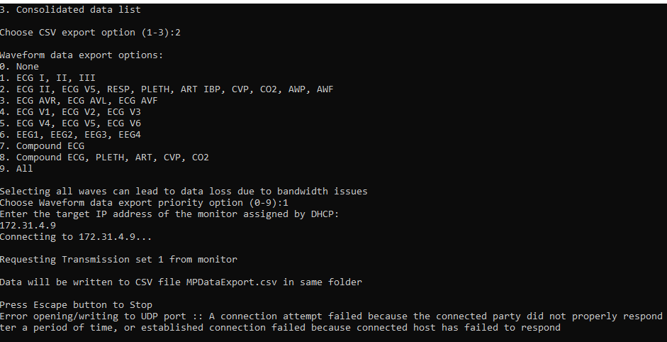
Data Extraction applying virtual signal
Notes:
Then we decided to use Virtual Signal, an open source script. But unfortunately it does not work.

Slide 13
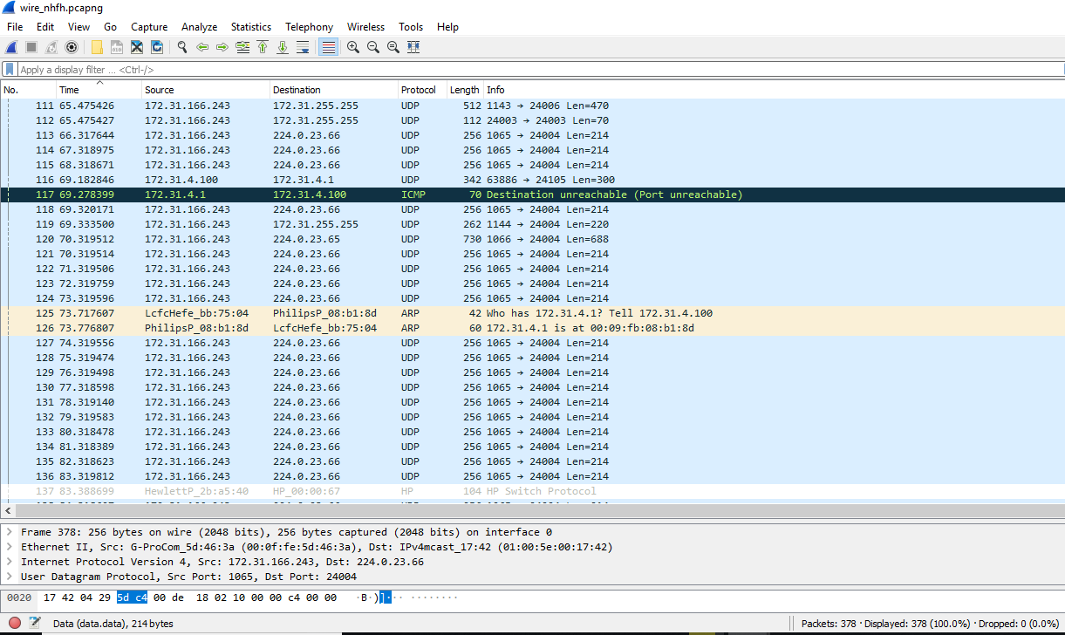
Data Extraction debugging packets
Notes:
To see what's happening we try wireshark packet analyzer. Where we get reply from PMU at only ICMP packets not other. After few research we found the data export interface of Phillips PMU does not work when it run on Bootp Server. It only work with manual IP which we have to configure from service mode. Unfortunately the service mode is locked with password.

Slide 14
Data Extraction data export test tool by philips
Notes:
Then we found DETT which developed by Phillips. So this time we don’t use LAN interface instead we use RS232 COM port and finally we can extract data from pmu

Slide 15
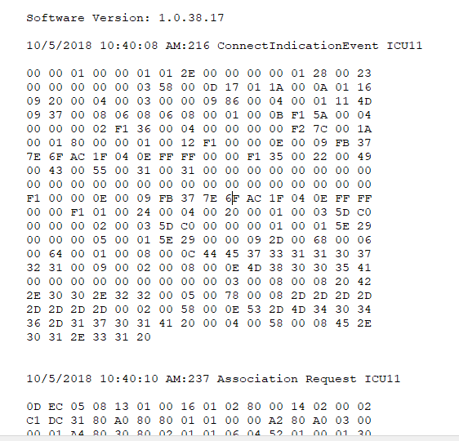
Data Extraction dett log file
Notes:
The best thing about DETT is, it can produce real-time data log file in txt format.

Slide 16
Data Extraction tentative
Map the parameters from the log file
Convert existing MATLAB code to more optimized code readable by microprocessor
Centralize the prototypes into one network
Notes:
So now we need to map the parameters of the log files and convert our code to read from it and run KOAD algorithm. Finally will make a separate network of emergency signaling system without effecting existing ICU system.

Slide 17
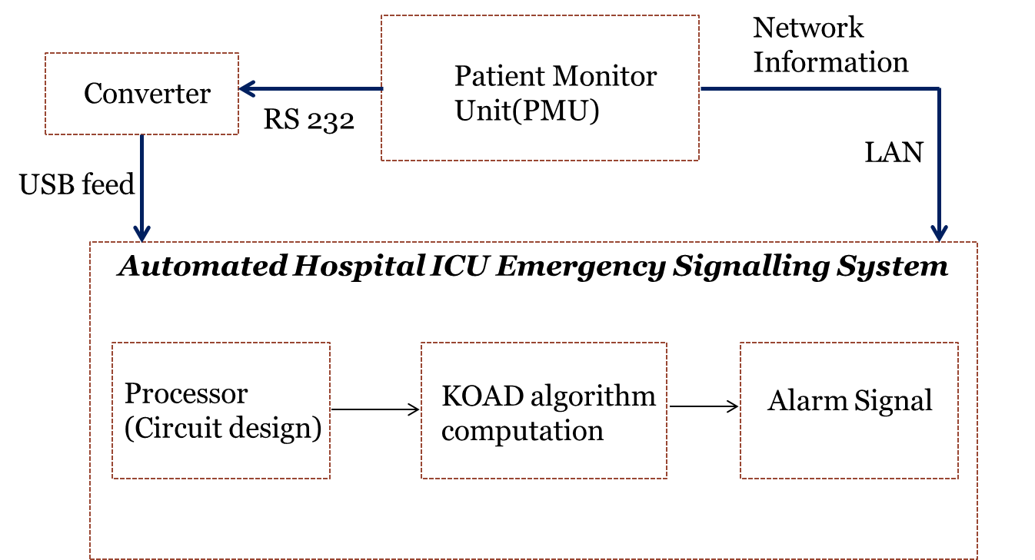
ICU Emergency Signaling System generic block diagram
Raw Data

Slide 18
Research Goals PROTOTYPE DESIGN
Relevant Peripherals Design
Data extraction methodology

Slide 19
Research Goals Interface Design
Maintain Alarming system properties
Approaches for false alarm deduction & reduction

Slide 20
Research Goals Interface Design
Control Room Design
IEC guideline 60601-1-11

Slide 21
Research Goals humanitarian
Publication
Patent

Slide 22
QUESTIONS & FEEDBACK

